Slide 1
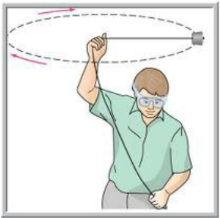
Circular Motion
In the Horizontal Plane

Slide 2
UNIFORM CIRCULAR MOTION
An object exhibiting uniform circular motion is accelerating towards the centre of the circle. Therefore, even if its’ speed around the circle is one constant value, the velocity of the object is continually changing.
Note that ‘a’ and ‘tangential v’ are perpendicular to one another.
Key:
= a (or a∆t)
= tangential v
= resultant v

Slide 3
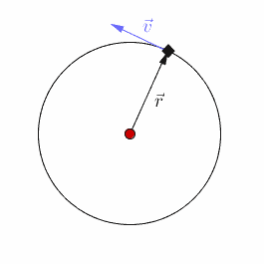

Slide 4
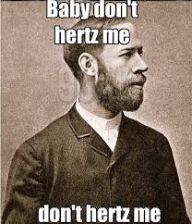
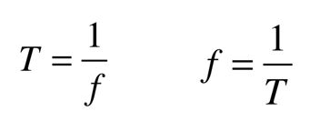
PERIOD & FREQUENCY
The time taken to complete one rotation about the circle is the period (𝚻 - usually measured in seconds).
The number of rotation completed in one second is the frequency (f - measured in Hertz).

Slide 5
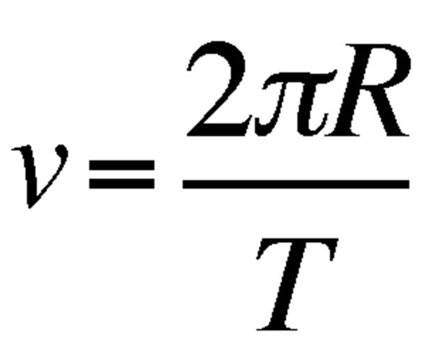
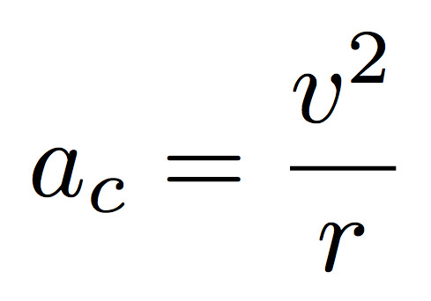
SPEED & CENTRIPETAL ACCELERATION
Speed = Circumference
Period
Centripetal Acceleration (acceleration towards the centre of the circle):

Slide 6
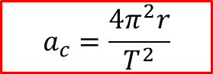

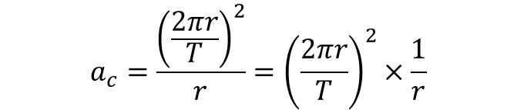

SPEED & CENTRIPETAL ACCELERATION
Combining the two…
$$a_{c}=\frac{v^{2}}{r}$$
$$a_{c}=\frac{{\left(\frac{2πr}{T}\right)}^{2}}{r}={\left(\frac{2πr}{T}\right)}^{2}×\frac{1}{r}$$
$$a_{c}=\frac{4π^{2}r^{2}}{T^{2}}×\frac{1}{r}$$
$$a_{c}=\frac{4π^{2}r}{T^{2}}$$

Slide 7
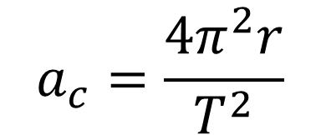
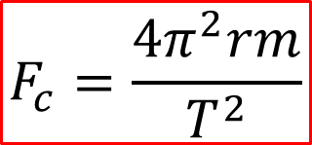
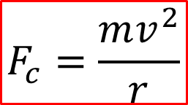
CENTRIPETAL FORCE
Acceleration
F = ma
$$F_{c}=\frac{mv^{2}}{r}$$
$$a_{c}=\frac{4π^{2}r}{T^{2}}$$
$$F_{c}=\frac{4π^{2}rm}{T^{2}}$$

Slide 8
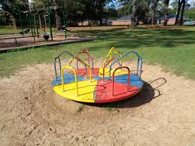
CENTRIPETAL FORCE
Centripetal force is directed towards the centre of the circle. Sometimes, people refer to centrifugal force (centre-fleeing force). They claim to feel this force when they ride a merry-go-round; when it spins fast enough, one gets the sensation of being ready to fall off.

Slide 9
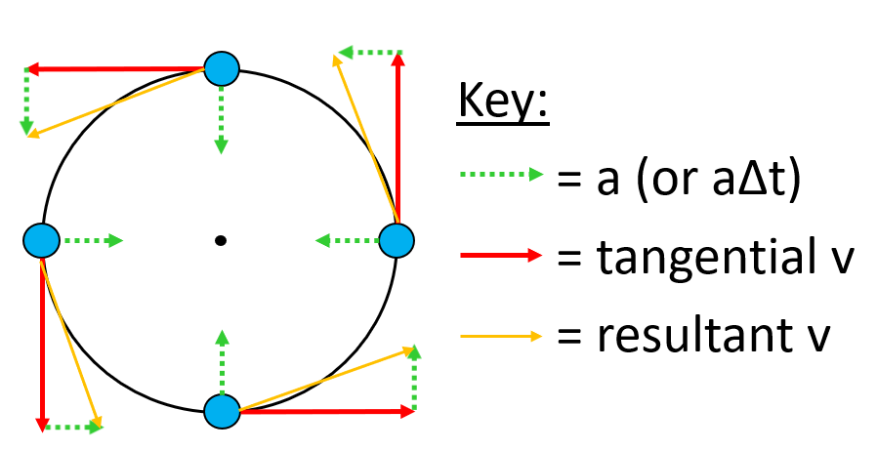
CENTRIPETAL FORCE
In reality, centrifugal force doesn’t really exist; the reason you feel like you might fall off of a merry-go-round is because of your inertia, which acts in the direction of the tangential velocity. If the merry-go-round stopped spinning suddenly, you would fly off (thanks to inertia).

Slide 10
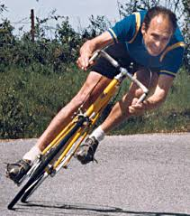
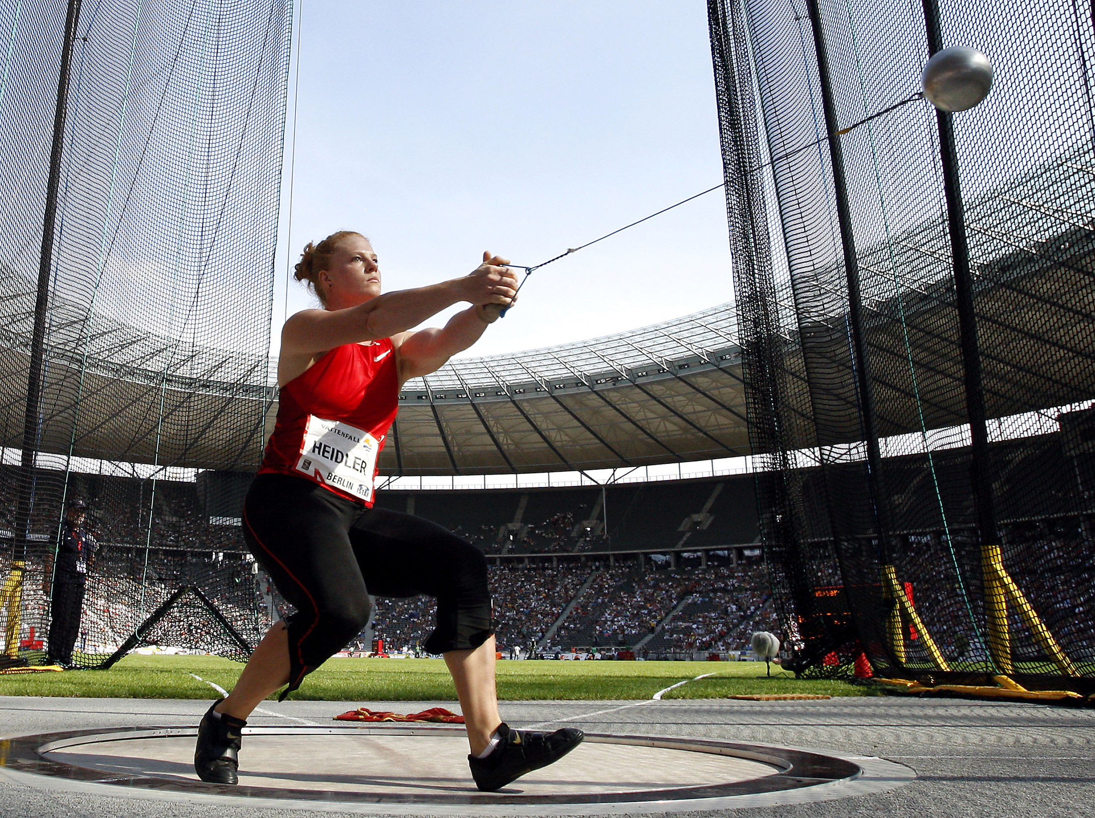
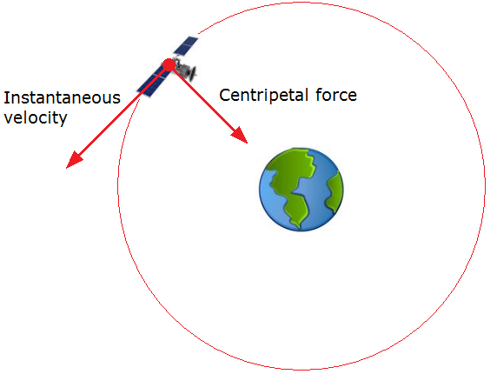
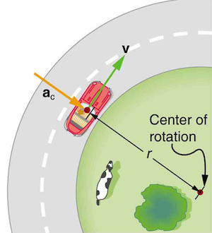
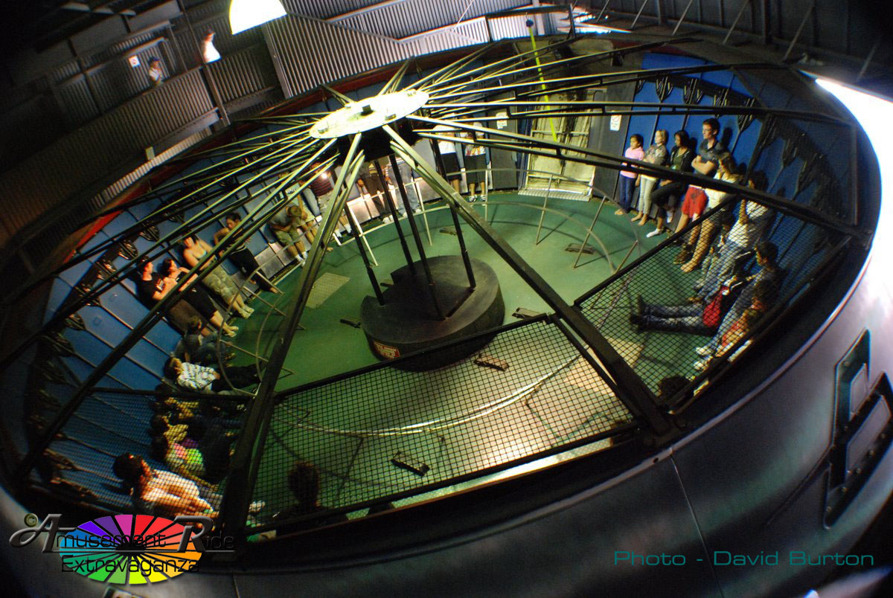
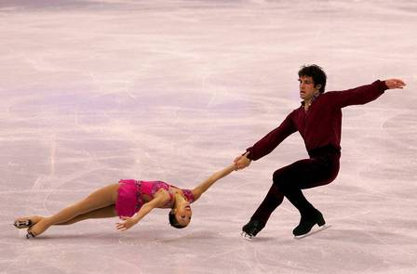
CENTRIPETAL FORCE
Centripetal force is not a new or distinct force – that is to say, it doesn’t exist on its’ own; centripetal force is always the result of other forces (i.e. tension, gravity, friction, normal force, etc.).

Slide 11
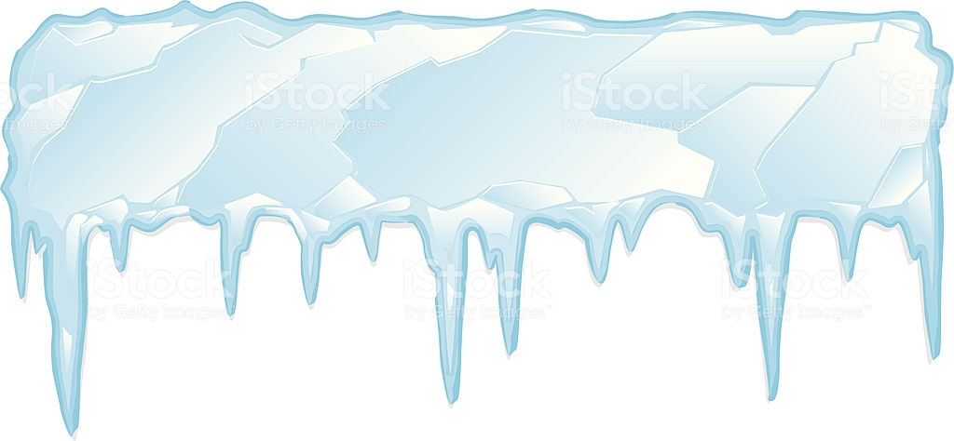
CENTRIPETAL FORCE
Normal Force
Ignoring friction, this could be considered an example of centripetal force due to normal force.
*In reality, the rider needs friction between the wheel and the road, or he’ll slip, but normal force can provide Centripetal Force as described!
Resultant Force (towards centre of circle)
i.e. Centripetal Force
Weight Force
Frictionless ice

Slide 12

CHANGING SPEED
$$F_{c}=\frac{mv^{2}}{r}$$
We know the expression for centripetal force. Suppose we are travelling in a circular (or semi-circular) path, such as when we round a corner while driving. What would happen if we were to suddenly increase our speed?
Answer: Mass wouldn’t change. Centripetal force is provided by friction in this example, so it would have a maximum limit. As speed increases, the required centripetal force increases also. When the maximum limit for friction, and therefore centripetal force at that radius, was reached, going faster would cause the radius to increase, in order to keep the centripetal force at the maximum magnitude allowed by the friction force providing it.

Slide 13
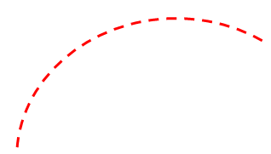
CHANGING SPEED
$$F_{c}=\frac{mv^{2}}{r}$$
Speed = v
(radius constant)
Speed > v
(radius increases, car
drifts off road)
Speed < v
(F_{C} not maxed out, so car stays on the road, held in place by friction. If car is run off the road, it is likely by angry motorists caught behind them…)

Slide 14
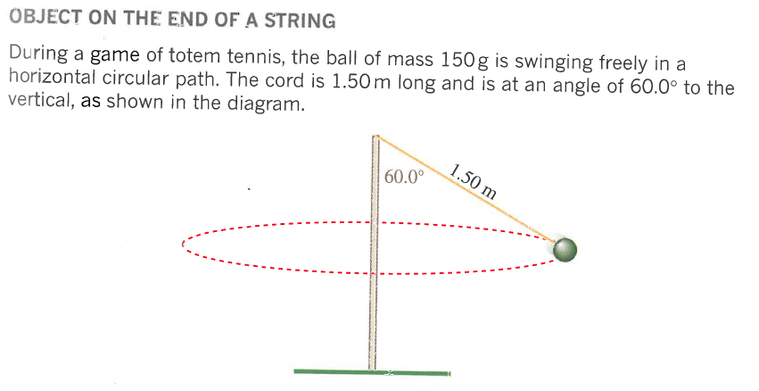
CONICAL PENDULUM
On the board:
Find radius.
Draw Force-diagram.
Find Centripetal Force.
Find Speed.
Find Tension in String.
Consider the angle of 60˚. Would it be possible to get it to 90˚ by swinging the ball faster? Yes or No? If not, why not?
Notes:
Pg. 69-70 of Pearson Physics (r=1.30m, Force Diagram = Fw & Fn, Fc=2.55N, v=?, Tension=2.94N, Could Never get to 90 degrees due to ‘g’ component).

